Slide 1
BB2950 Day 26: Monday 12-11-17
Learning objectives:
Describe some of the ways in which TFs themselves are regulated.
Explain how the lac operon is regulated in E. coli.
Explain how groups of genes can be coordinately regulated.
Microphone

Slide 2
Course evaluations and TA evaluations
Paper forms: evaluate Prof. Shell and the course
Volunteer to bring completed surveys to the Academic Advising office in Daniels Hall?
Qualtrics survey available in the “quizzes” tab in Canvas: evaluate TA David Dolivo
“Quiz” will be available until 5 pm on Wed Dec 11
Please take the next 15 minutes to fill out both of these!
Thank you in advance for your specific, constructive feedback!

Slide 3
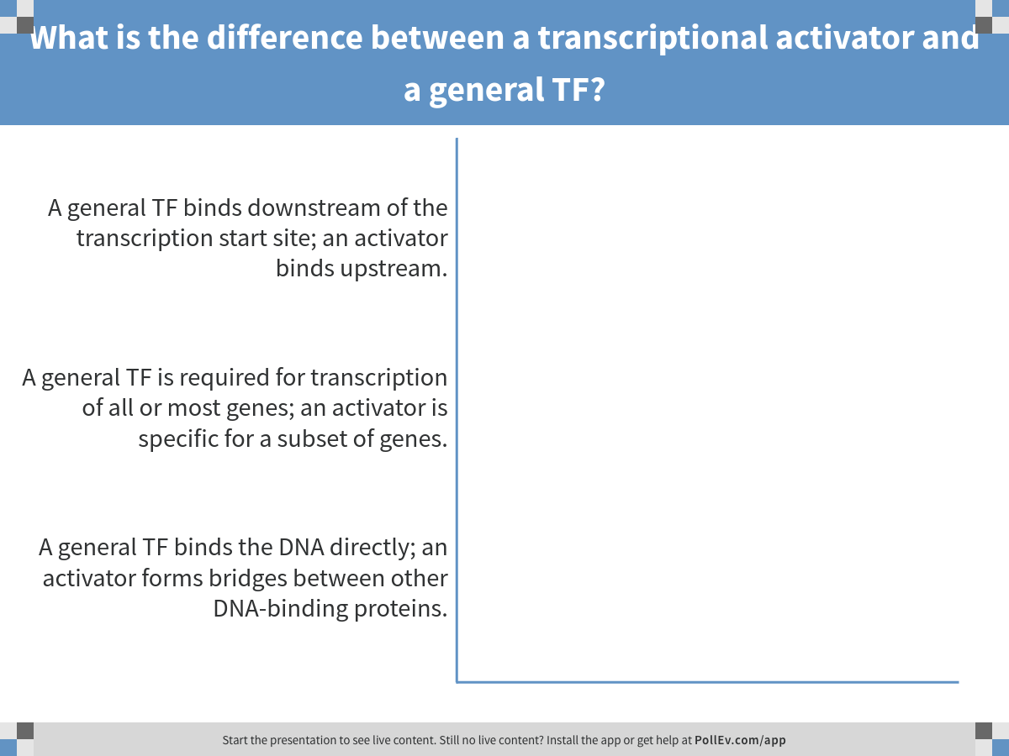
Notes:
What is the difference between a transcriptional activator and a general TF?
https://www.polleverywhere.com/multiple_choice_polls/MzdXyTYtvlN8NPk

Slide 4
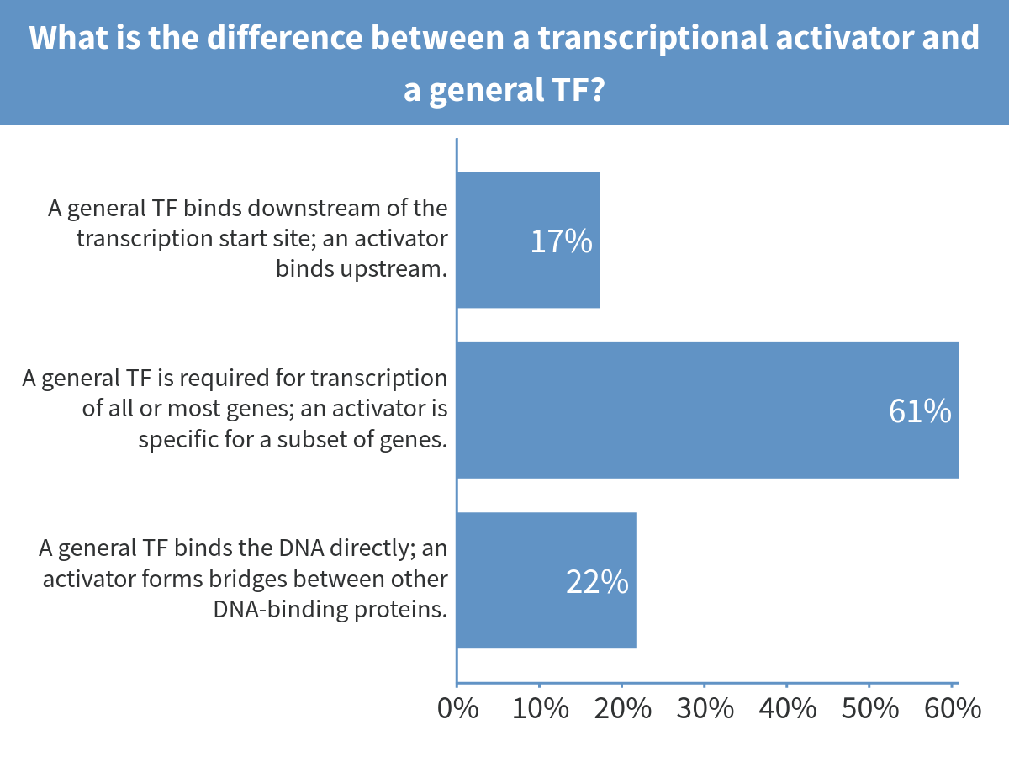
Notes:
What is the difference between a transcriptional activator and a general TF?

Slide 5
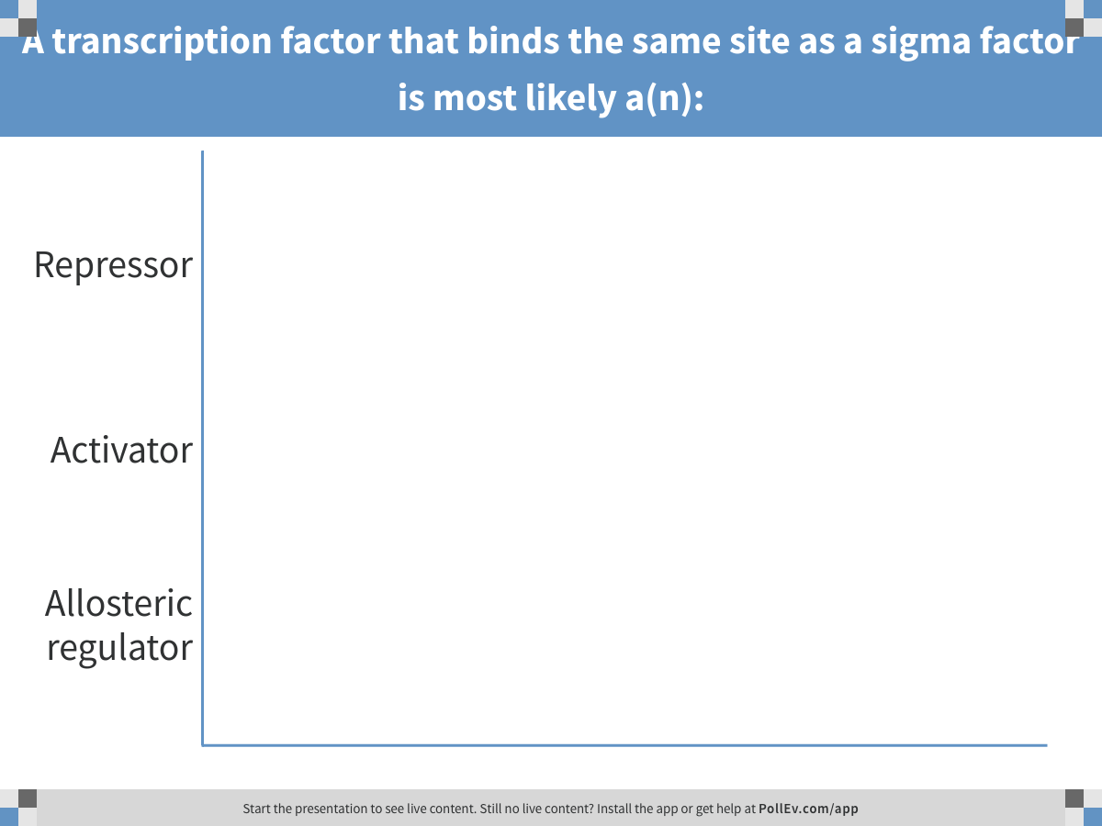
Notes:
A transcription factor that binds the same site as a sigma factor is most likely a(n):
https://www.polleverywhere.com/multiple_choice_polls/dS015I5oh99XXeq

Slide 6
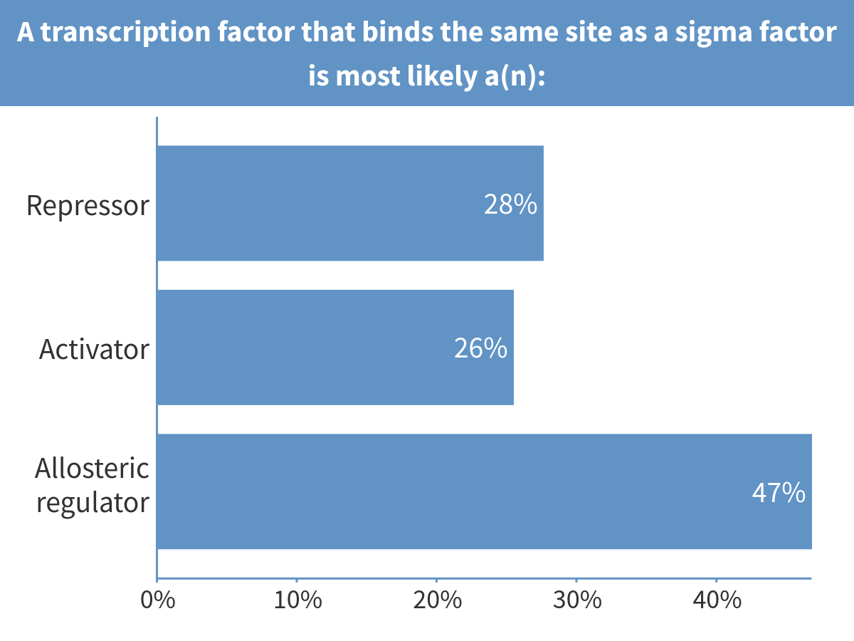
Notes:
A transcription factor that binds the same site as a sigma factor is most likely a(n):

Slide 7
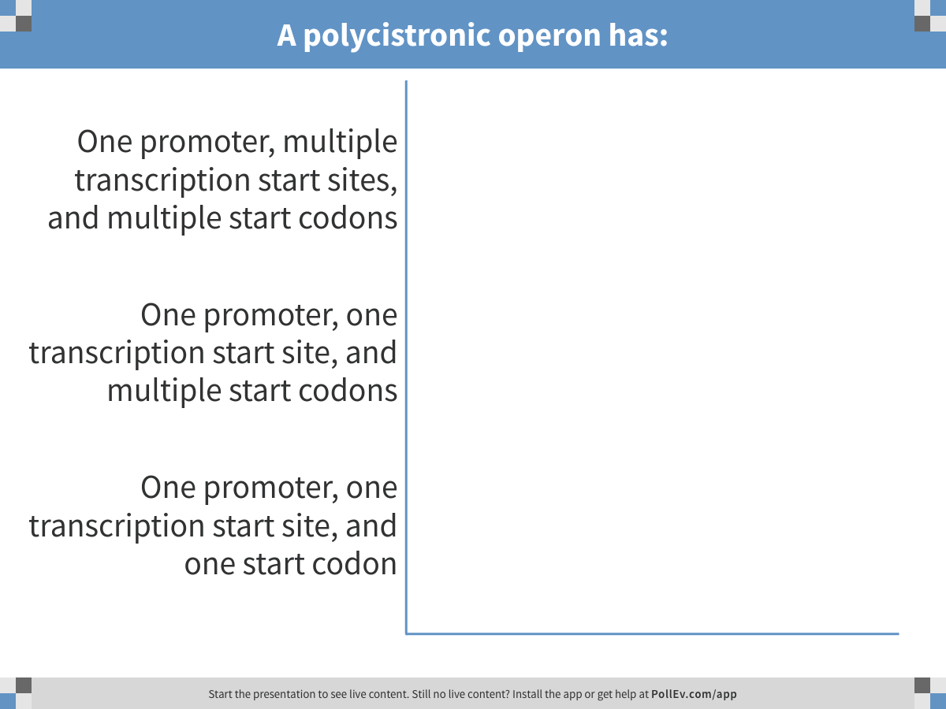
Notes:
A polycistronic operon has:
https://www.polleverywhere.com/multiple_choice_polls/oPUshfDEfrQRlaj

Slide 8
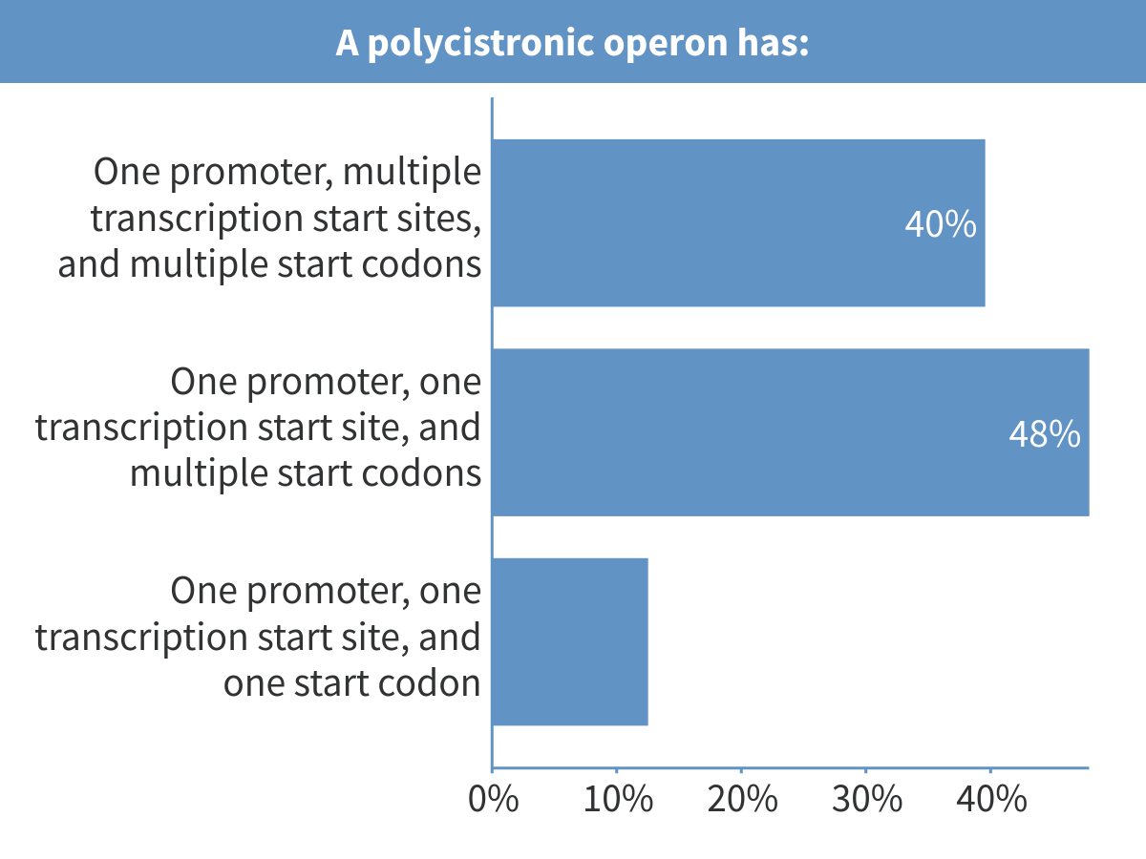
Notes:
A polycistronic operon has:

Slide 9
What regulates the activators and repressors?

Slide 10
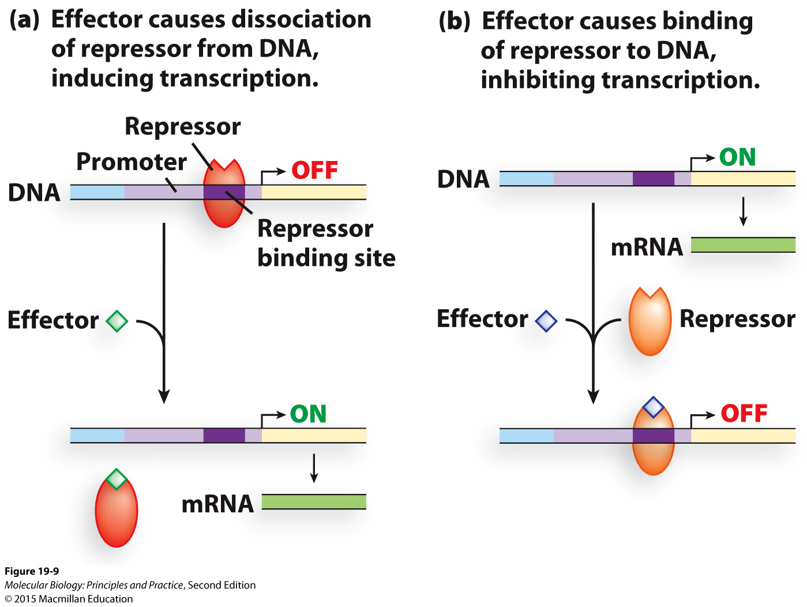
Small-molecule effectors can relieve repression or cause repression

Slide 11
How does a small molecule change the activity of the repressor?

Slide 12
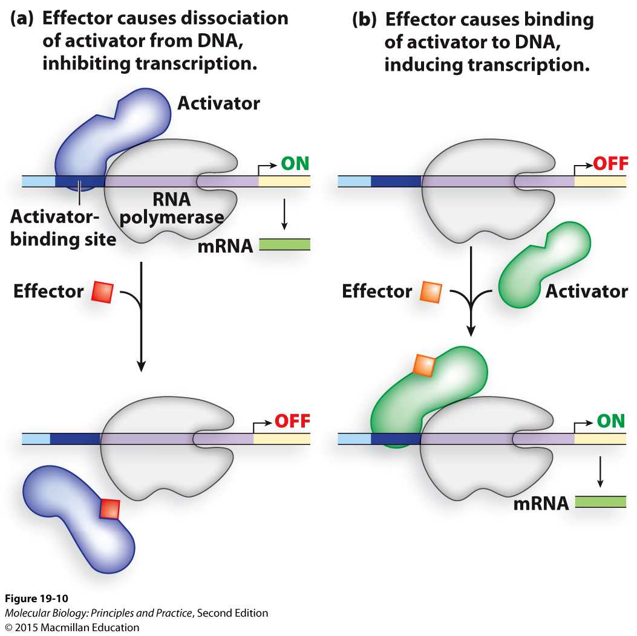
Small-molecule effectors can induce or inhibit activator activity

Slide 13
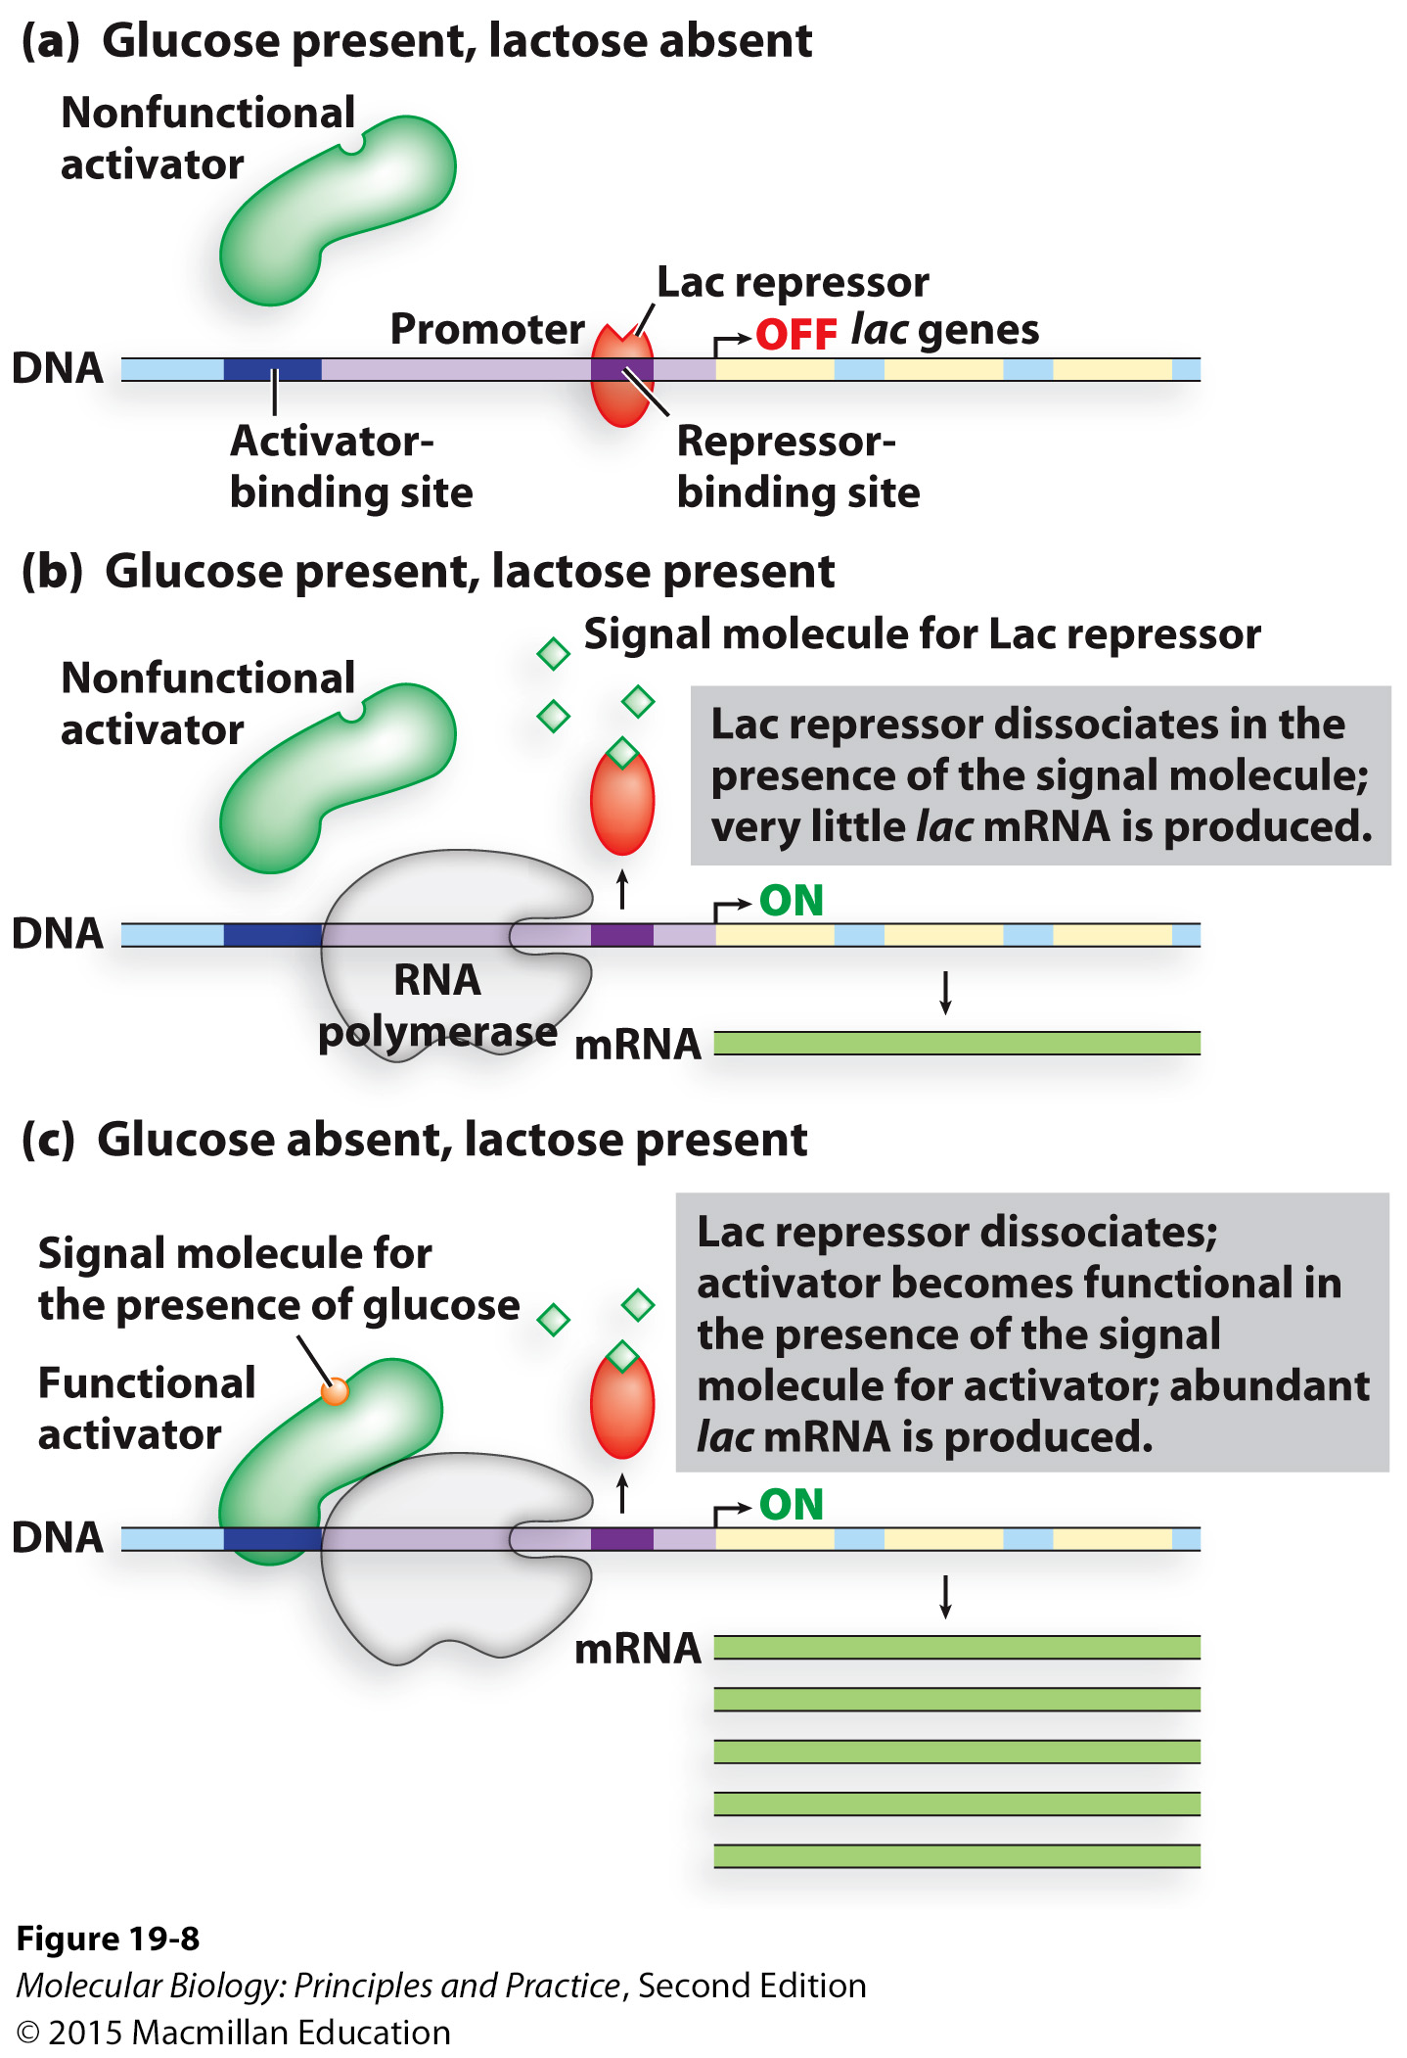
Expression of a particular gene is often the product of multiple regulators
absence

Slide 14
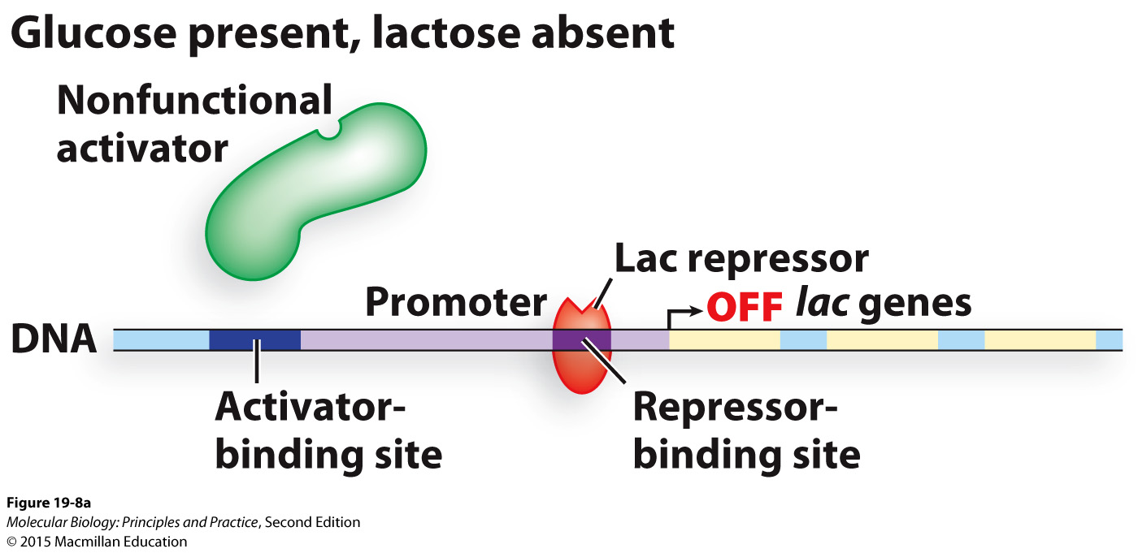
Control of the lac operon in E. coli

Slide 15
Control of the lac operon in E. coli
Under what conditions would E. coli want to express the lac operon?

Slide 16
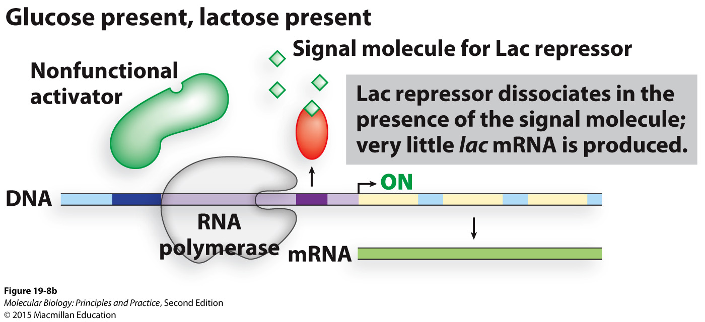
Control of the lac operon in E. coli

Slide 17
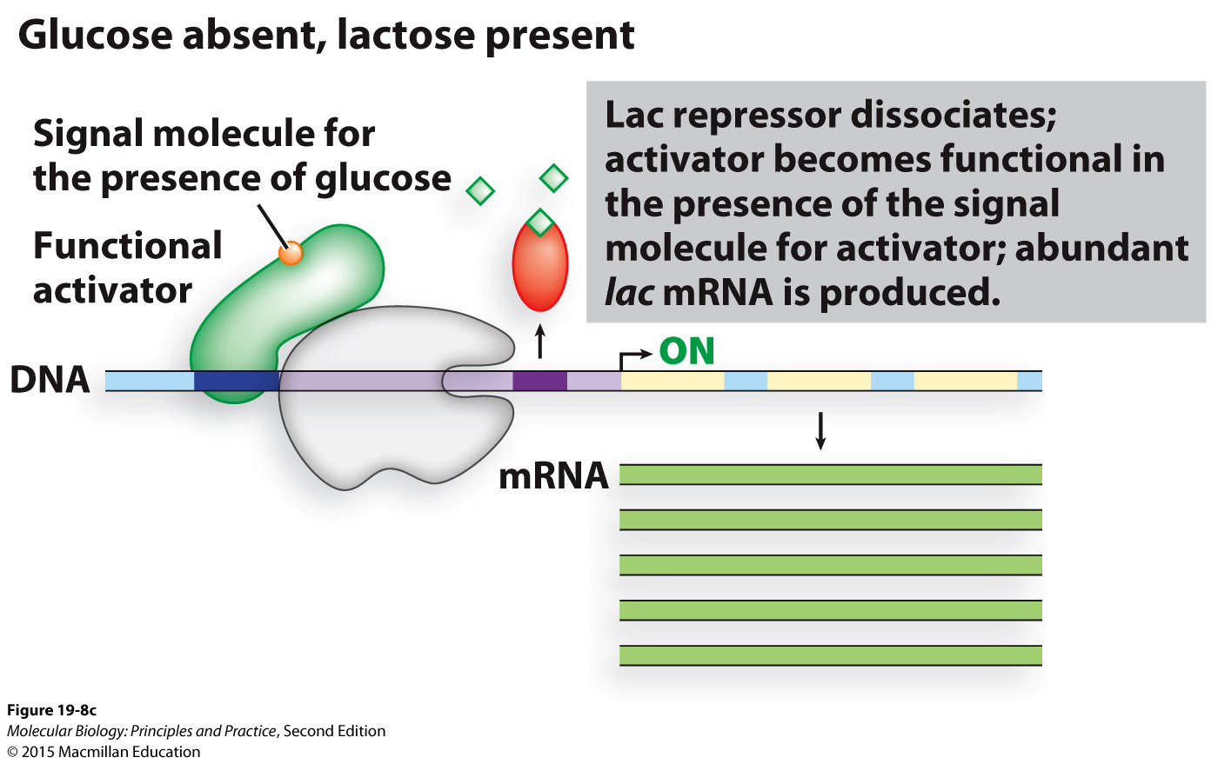
Control of the lac operon in E. coli

Slide 18
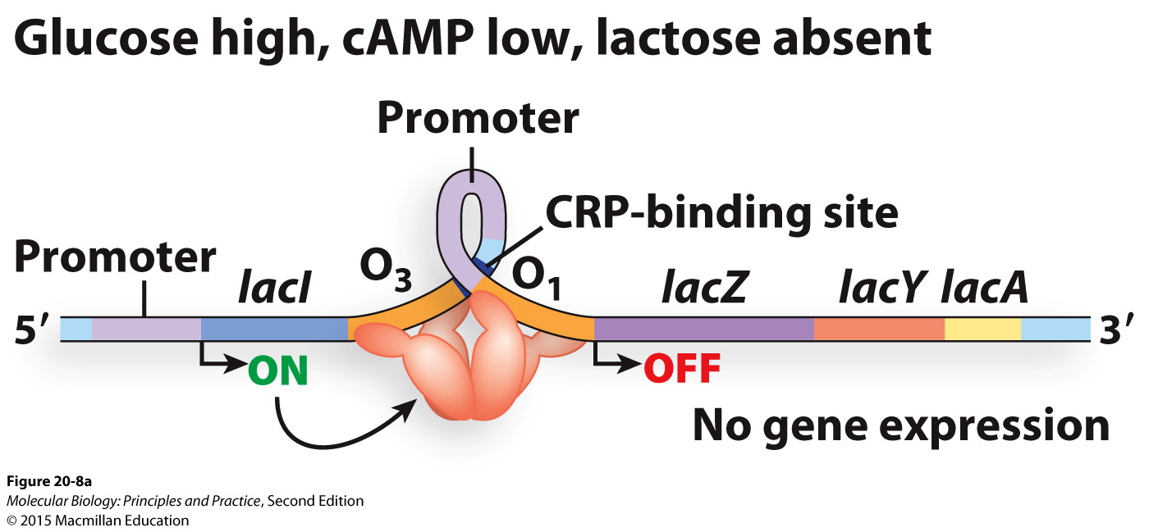
Control of the lac operon in E. coli: more detail

Slide 19
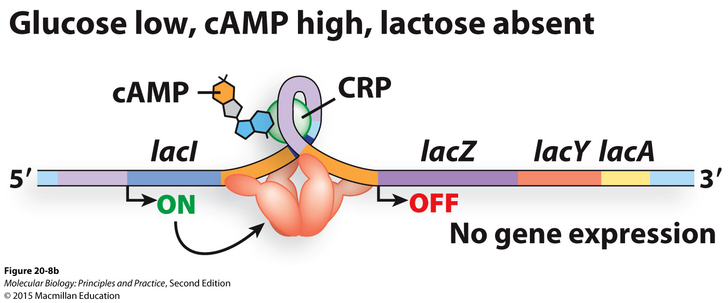
Control of the lac operon in E. coli: more detail

Slide 20
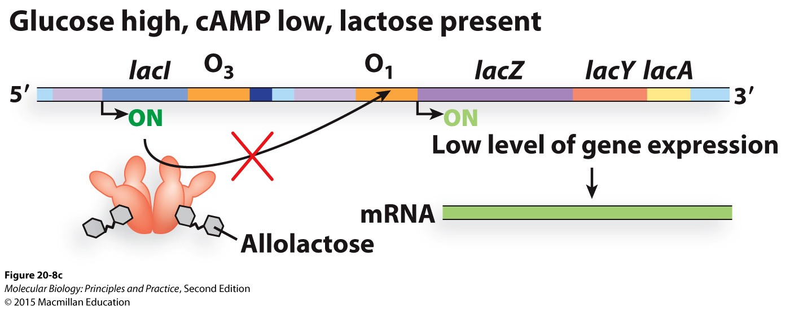
Control of the lac operon in E. coli: more detail

Slide 21
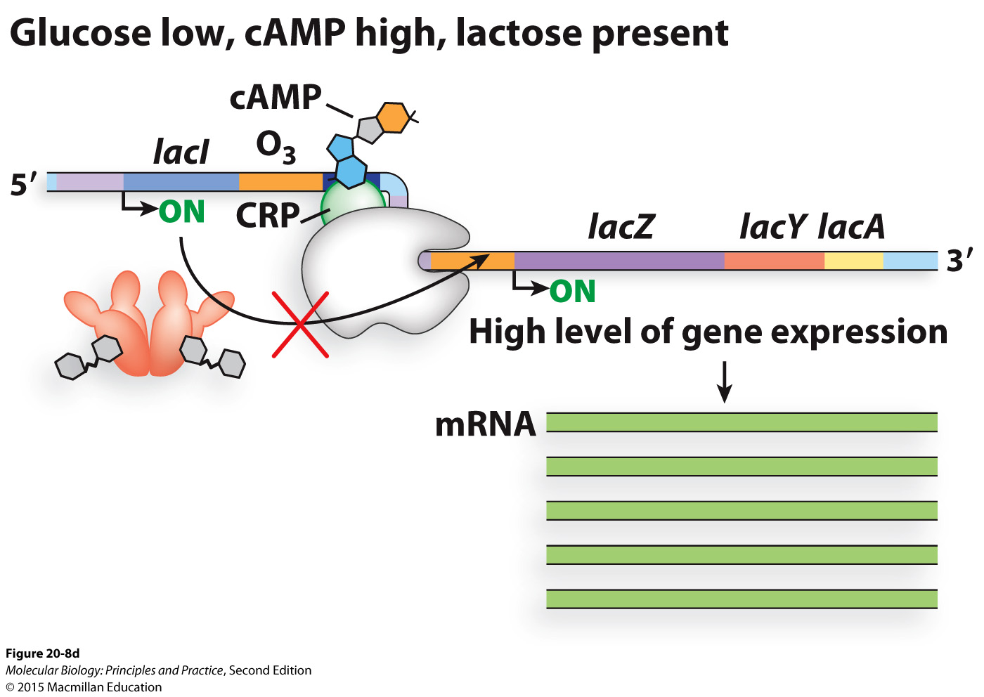
Control of the lac operon in E. coli: more detail

Slide 22
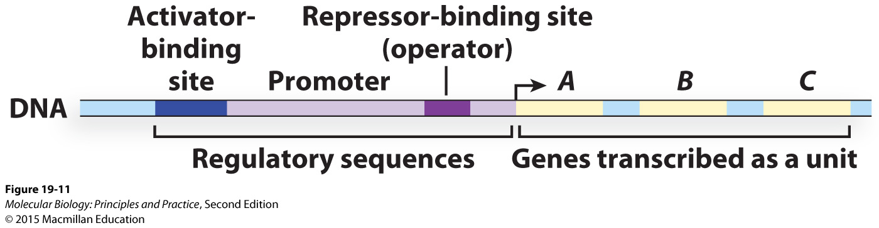
Operons (polycistronic transcripts) allow multiple genes to be co-regulated
Notes:
Many bacterial genes, but not all.

Slide 23
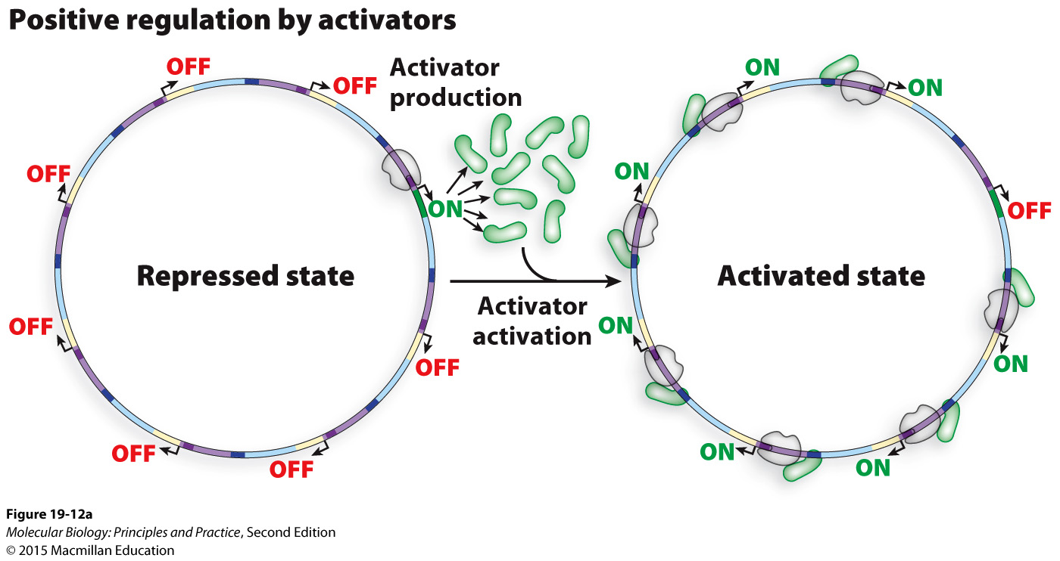
Many spatially distant genes can be co-regulated by virtue of a common TF binding site

Slide 24
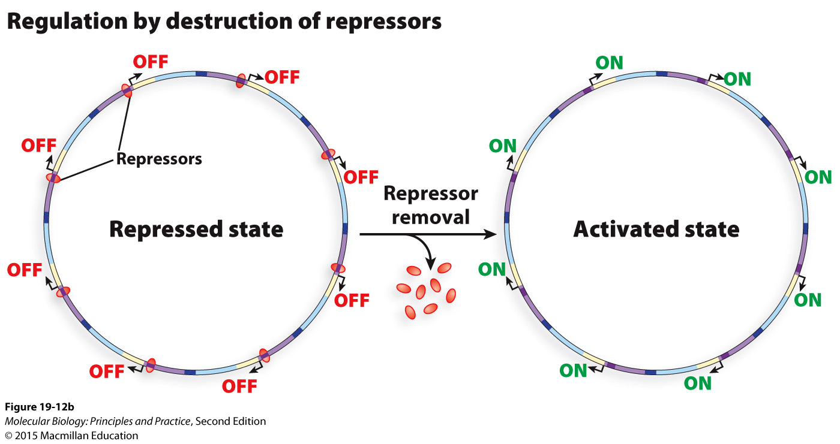

Slide 25
Median: 73
Mean: 69.58

